Slide 1
Genetics of Obesity

Slide 2
Learning Objectives
Understand the proportion of obesity that is heritable
Describe different modes of inheritance at a molecular level
Explain the difference between the effects of inherited environment and genetics
Discriminate between the methodologies used to identify rare and common obesogenic variants
Arrange known genetic variants in the context of change in energy balance
Interpret the relative heritability of both energy intake and energy expenditure
Apply knowledge of obesogenic variants to potential individualized treatments
Distinguish between variants that predispose to obesity and variants that increase risk of obesity-related diseases

Slide 3
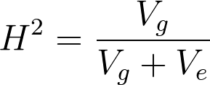
What Do We Mean by Heritable?
The proportion of variance that is attributable to genetics
NOT the percent of the weight
Calculated by this equation:
http://johnhawks.net/explainer/stats/heritability-and-stature/

Slide 4
What are some heritable traits?

Slide 5
Heritable vs Familial
Familial
Traits are shared by relatives for any reason
Heritable
Similarities arise from shared genotypes
Activity: Discuss some aspects of obesity that you think would be heritable vs familial. How would you discriminate between them?

Slide 6
Twin Studies and Obesity Heritability
H² = 0.70 for men, 0.66 for women
Several other twin studies with ranges from 0.60-0.75
Stunkard AJ, Harris JR, Pedersen NL, McClearn GE. The Body-Mass Index of Twins Who Have Been Reared Apart. N Engl J Med. 1990; 322: 1483–7. doi: 10.1056/NEJM199005243222102.

Slide 7
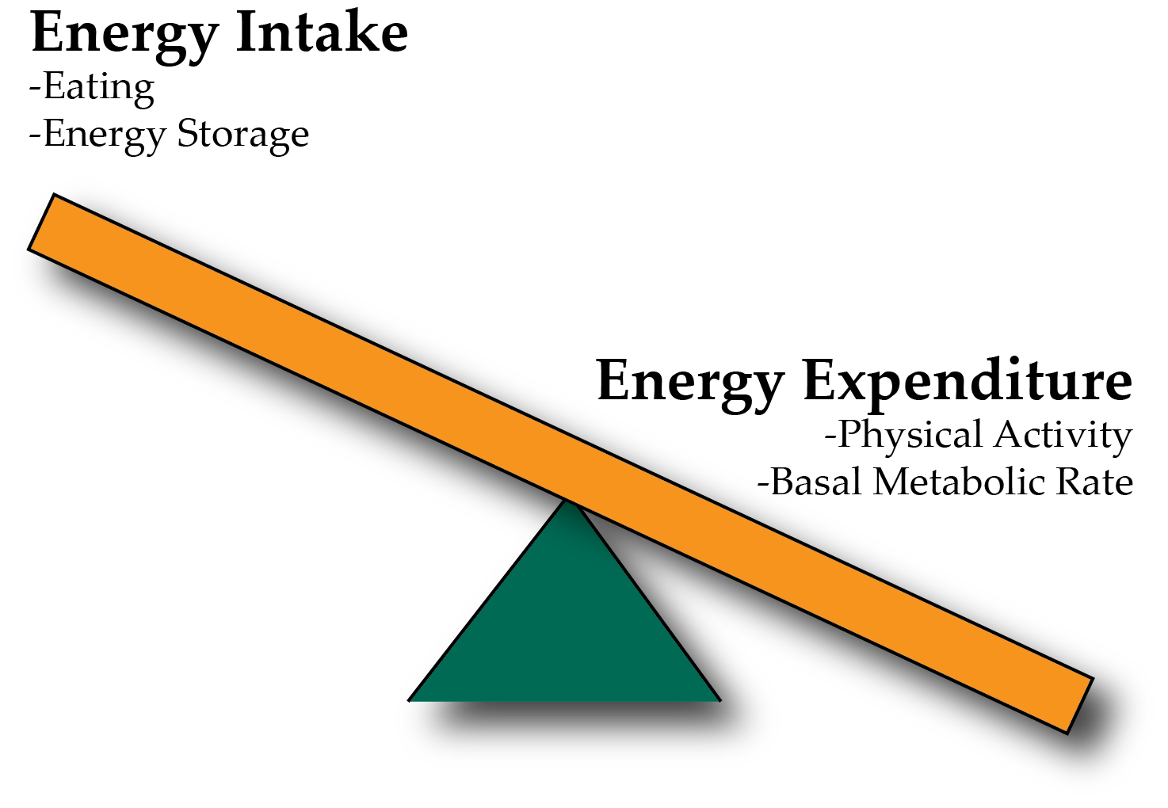
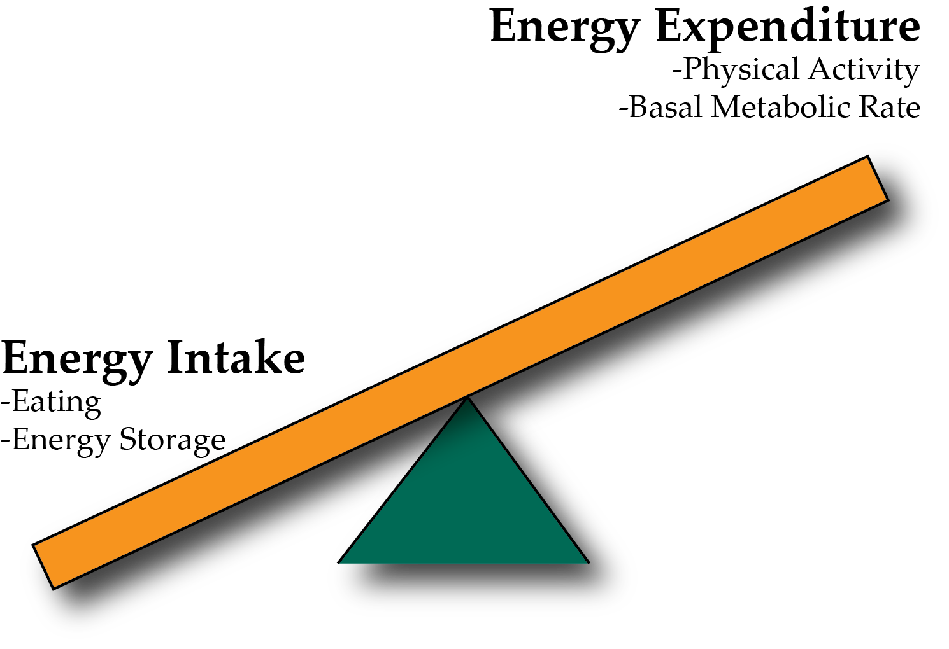
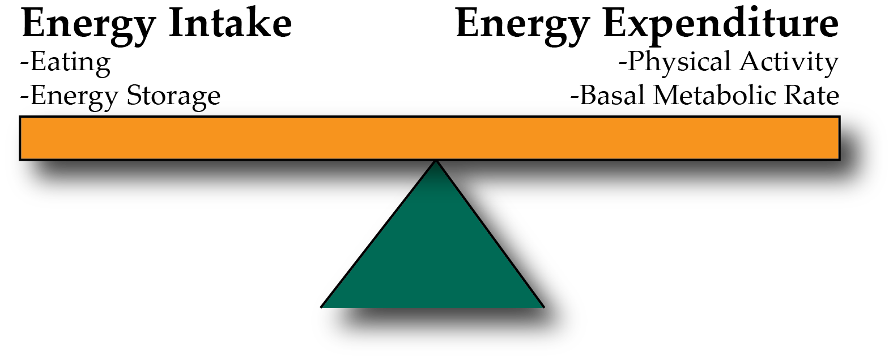
Energy Balance and Obesity
Positive Energy Balance – Weight Gain
Negative Energy Balance – Weight Loss

Slide 8
Heritability of Energy Intake

Slide 9
Heritability of Energy Expenditure

Slide 10
Can the environment modify obesity heritability?
Discuss amongst yourselves

Slide 11
How do we identify genes that cause obesity?
Pedigree studies
Rare
Highly penetrant
Genome-wide association studies
Common
Small effect sizes
https://www.nature.com/scitable/topicpage/multifactorial-inheritance-and-genetic-disease-919

Slide 12
Identification of Leptin as a Rare Syndromic Form of Obesity
Montague CT, Farooqi IS, Whitehead JP, Soos M a, Rau H, Wareham NJ, Sewter CP, Digby JE, Mohammed SN, Hurst JA, Cheetham CH, Earley a R, Barnett a H, et al. Congenital leptin deficiency is associated with severe early-onset obesity in humans. Nature. 1997; 387: 903–8. doi: 10.1038/43185.

Slide 13
Leptin is an appetite suppressant from fat tissue

Slide 14
Leptin deficiency is treatable with recombinant leptin
Farooqi IS, Jebb SA, Langmack G, Lawrence E, Cheetham CH, Prentice AM, Hughes IA, McCamish MA, O’Rahilly S. Effects of recombinant leptin therapy in a child with congenital leptin deficiency. N Engl J Med. 1999; 341: 879–84. doi: 10.1056/NEJM199909163411204.

Slide 15
Most syndromic forms of obesity associate with appetite control
Common Name | Locus | Heritability | Occurrence
Leptin | LEP
Leptin Receptor | LEPR
Melanocortin (α-MSH) | POMC
Melanocortin Processing | CPE
Melanocortin Receptor | MC4R
WAGRS Syndrome (Obese) | BDNF
BDNF Receptor | NTRK2
Prader-Willi | Several genes at 15q23
Barnet-Biedel Syndrome | Several BBS genes

Slide 16
Role of Leptin, Melanocortin and BDNF in appetite control

Slide 17
Discuss amongst yourselves
You come across a patient with severe, early onset obesity. They have a mutation in MC4R that blocks the ability of that receptor to function at all.
Would this person be expected to hyperphagic or anorexic? Why or why not?
Would leptin therapy be effective in this patient? Why or why not?
What other treatments might you suggest (either pharmacological or other).

Slide 18
Common variants associated with obesity

Slide 19
How good are we at predicting obesity from genomic data?

